Slide 1
RF readout figures Delft

Slide 2
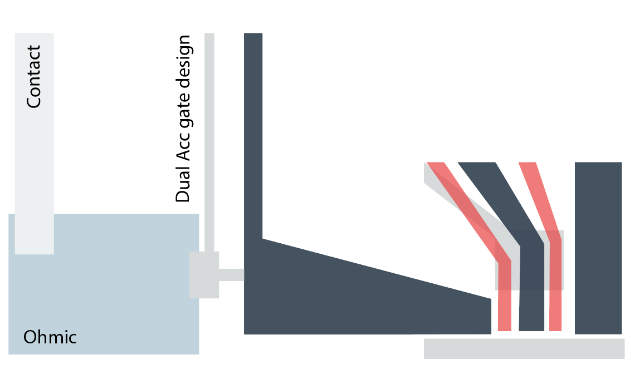
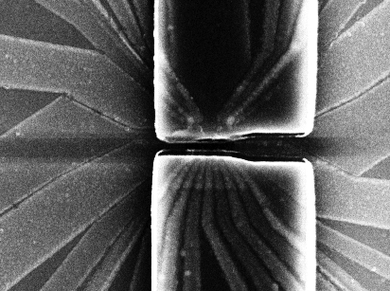
Device design
(a)
(b)
(c)
Notes:
(a) SEM a quad dot device, similar to the device that has been used to demonstrate RF readout using the lead gate approach.
(b) Schematic showing an example device design for the RF readout with lead gate approach. In this case the accumulation gate has been split in two. This allows one to control the impedance between the ohmic and the 2DEG. The RF signal is applied on the second accumulation gate. The signal couples capacitively in the 2DEG (C2deg). The first lead gate is biased in such that the resistance at the junction is ~10MOhm (Rohmic/2deg), in this way, the signal will see only the impedance of the sensing dot (Rsd).
(c) Circuit diagram, showing a basic model for RF readout using the lead gate approach.

Slide 3
Theory data (we could drop this as it is quite textbook)
(a)
(b)
(c)
(d)
Notes:
In panel, on the x and y axis, the parasitic capacitance is varied (e.g. capacitance of bond wires, metal gates of the sample to ground) versus the inductance of the inductor.
Panel (a) shows the expected resonance frequency of the matching circuit, (b) shows the matching resistance , (c) shows the expected quality factor of the circuit. Panel (e) gives the expected sensitivity of the sensing dot in a range designed form 100k to 1M. (to be explained in the main text)
The orange dot shows the parameters for the device tested in this paper.
NOTE PANEL C :: experimentally our quality factor seems much higher than the one expected from the simulations, unclear why/ (Q=241) || also the Q is high for high inductance, inverse of expected behaviour, this simulation needs to be checked.

Slide 4
Experimetal data
(a)
(b)
Not noise, biasT effect when making the correlation between measured current and S11 (corrected manual)
Issue with setting filter function (DSP) for first part of the data.
(needs a retake)
(c)
(d)
(2,1)
vP3 (mV)
(1,1)
(0,1)
(1,0)
(2,0)
vP4 (mV)
Notes:
Experimental data
Response of the matching circuit to a change in resistance of the sensing dot. The bandwidth of the circuit is expected to be ~0,8MHz from fitting the curve around the matching point.
Plot showing the response at the resonant frequency of the LCR circuit. R is varied by change the resistance of the sensing dot. The circuit matches at 275kOhm.
Charge stability diagram of dot 3 and 4. The line in the figure shown the transition that is probed in panel (d)
Infidelity of the charge detection versus time. The green line shows the fidelity of when going from the top of a coulomb peak to the bottom. The blue lines shows the fidelity for detecting a charge jump with a given length. The measurements were carried out by sending a block pulse of with a frequency corresponding to the measurement time (the tunnel rate was set to be larger than measurement time). The response was measured, the fidelity was established by thresholding the data (the number of samples is 1e4).

